Slide 1
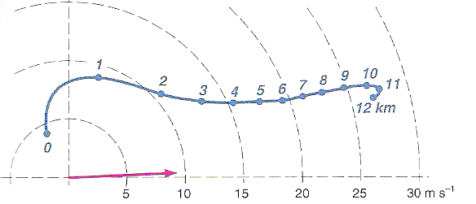
Composite Supercell Hodograph
Note the storm motion (pink) lies off the hodograph and to the right of the mean wind.
The hodograph has strong cyclonic curvature in the lowest 1-3 km and is nearly straight above.
Markowski and Richardson (2010), their Fig. 8.15

Slide 2
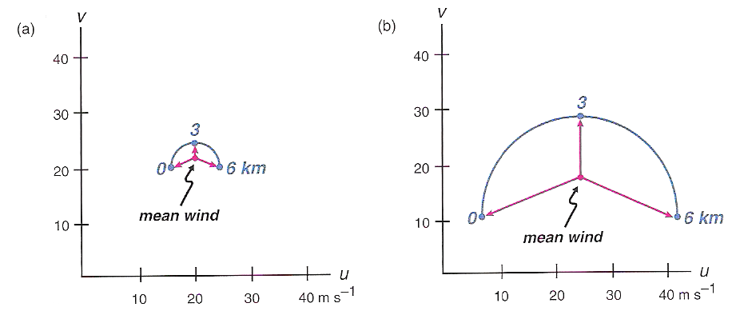
Non-Supercell vs. Supercell Hodographs
Non-supercell: weak shear
Weak storm-relative winds
Supercell: strong shear
Fast storm-relative winds
Markowski and Richardson (2010), their Fig. 8.2

Slide 3
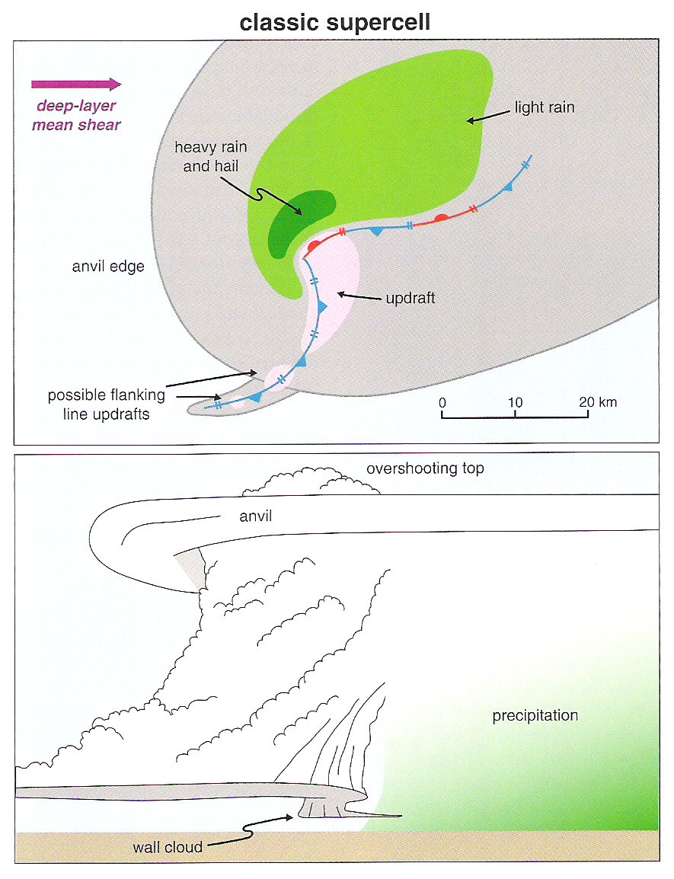
Classic Supercell Schematic
Precipitation primarily falls downshear due to the direction of the storm-relative winds in the upper troposphere (where precipitation largely forms).
The wall cloud forms as rain-cooled and stabilized air along the forward-flank gust front is mechanically forced to ascend by the strong supercell updraft.

Slide 4
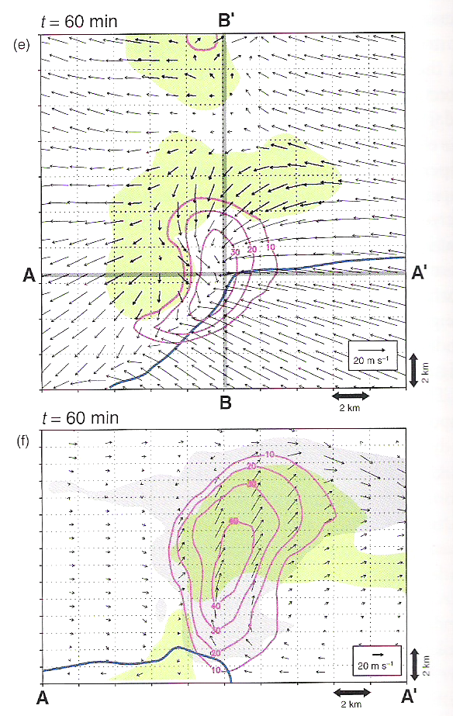
Classic Supercell Structure
Note the placement of the precipitation (green): downshear on the forward flank, wrapping in a hook- or kidney bean-like shape around the updraft on the rear flank.
Note the placement of the updraft (magenta) relative to the rear-flank gust front: nearly collocated.
Markowski and Richardson (2010), their Fig. 8.3e,f

Slide 5
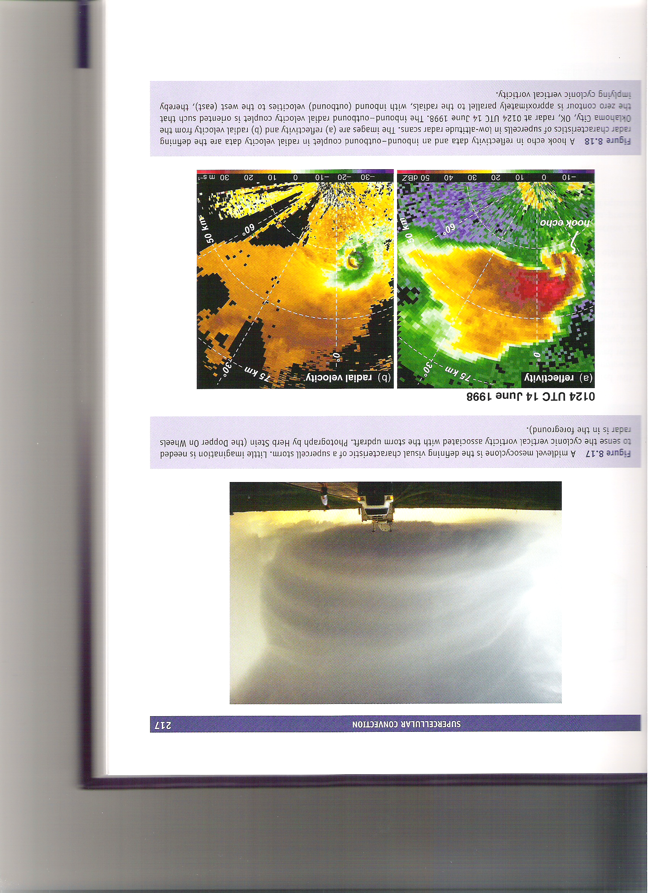
Classic Supercell Structure
The implied cyclonic curvature to the cloud indicates a collocated updraft and mesocyclone.
Markowski and Richardson (2010), their Fig. 8.17

Slide 6
Classic Supercell Structure
mesocyclone
Features evident on previous slides are present here as well.
Markowski and Richardson (2010), their Fig. 8.18

Slide 7
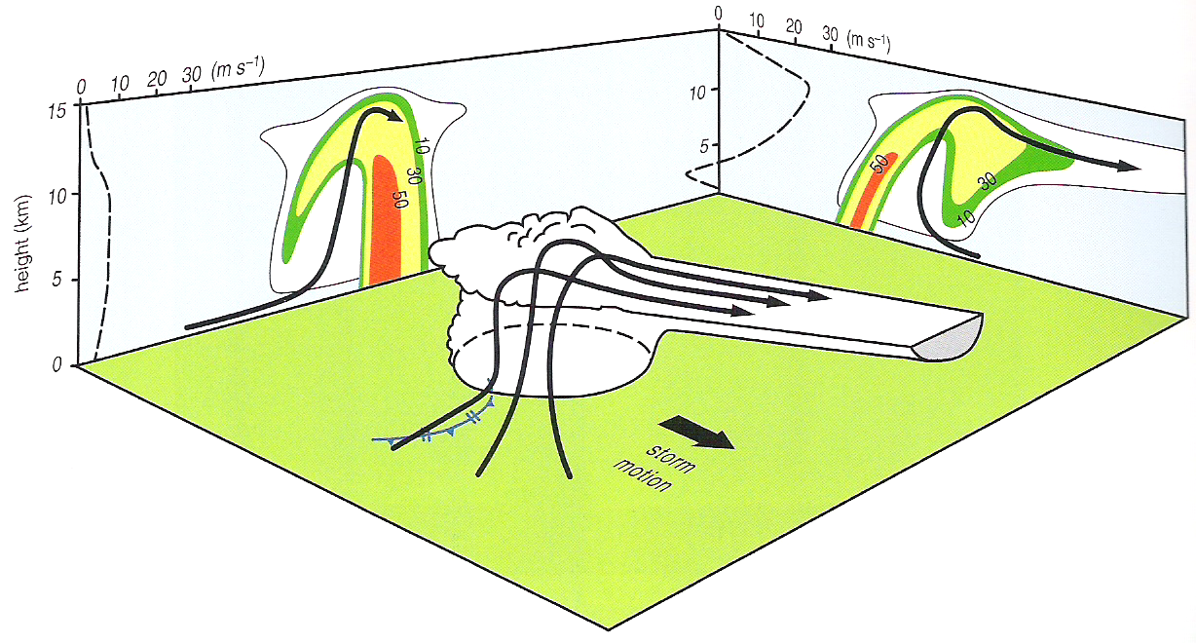
Classic Supercell Structure
storm-relative zonal wind
storm-relative meridional wind
BWER
WER
Storm-relative inflow at low levels retards outward gust front propagation and outflow aloft promotes downwind deposition of hydrometeors and precipitation.
Markowski and Richardson (2010), their Fig. 8.19

Slide 8
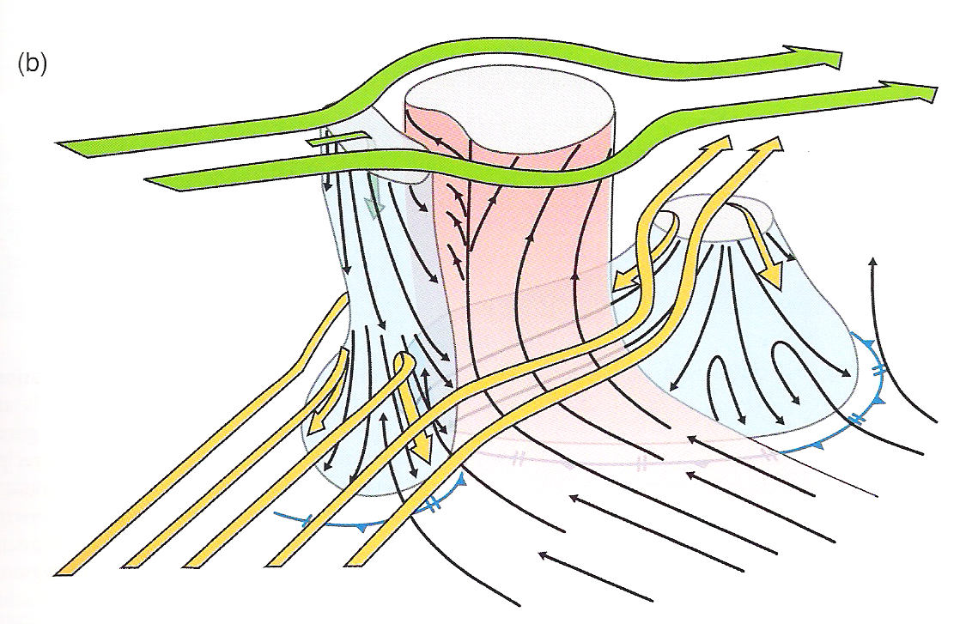
Classic Supercell Structure
Markowski and Richardson (2010), their Fig. 8.20

Slide 9
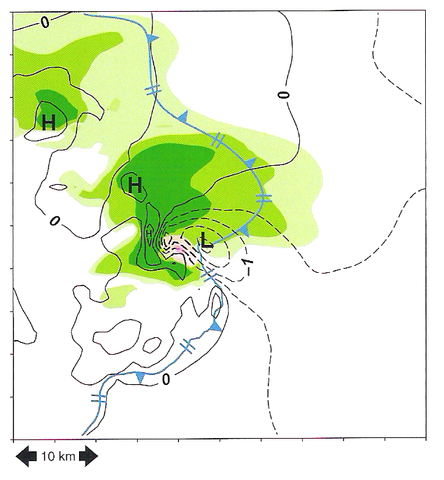
Classic Supercell Structure
Acceleration of inflow toward the updraft results in the formation of an inflow low, even in parts of the forward-flank downdraft air. Negative buoyancy leads to anomalous high pressure elsewhere in the rear- and forward-flank downdrafts.
Markowski and Richardson (2010), their Fig. 8.23

Slide 10
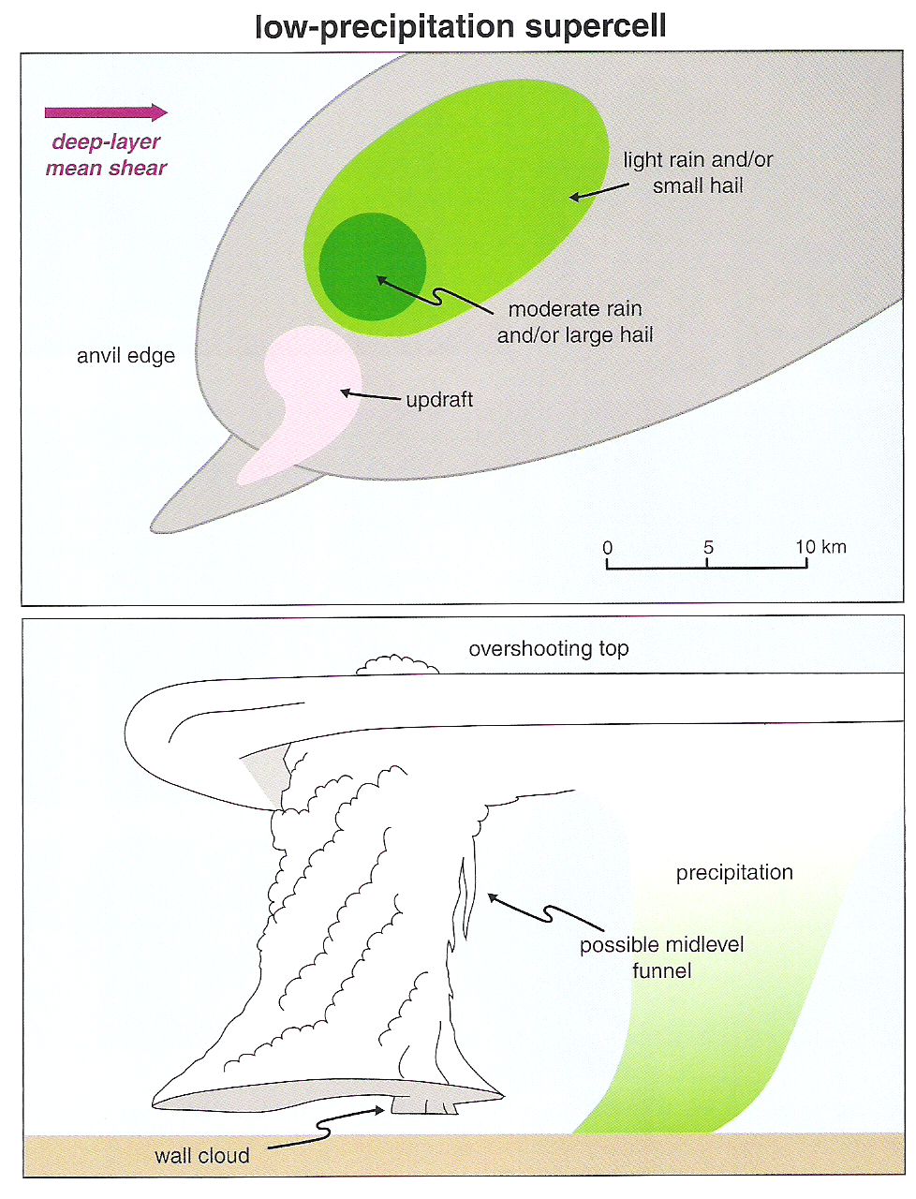
Low Precipitation Supercell Structure
Upper-level storm-relative winds are comparatively fast, and often the environments in which LP supercells form are comparatively dry.
This displaces the hydrometeors well downshear, most of which evaporate before reaching the ground upon fallout. Downdraft buoyancy deficits are relatively small.
Markowski and Richardson (2010), their Fig. 8.24

Slide 11
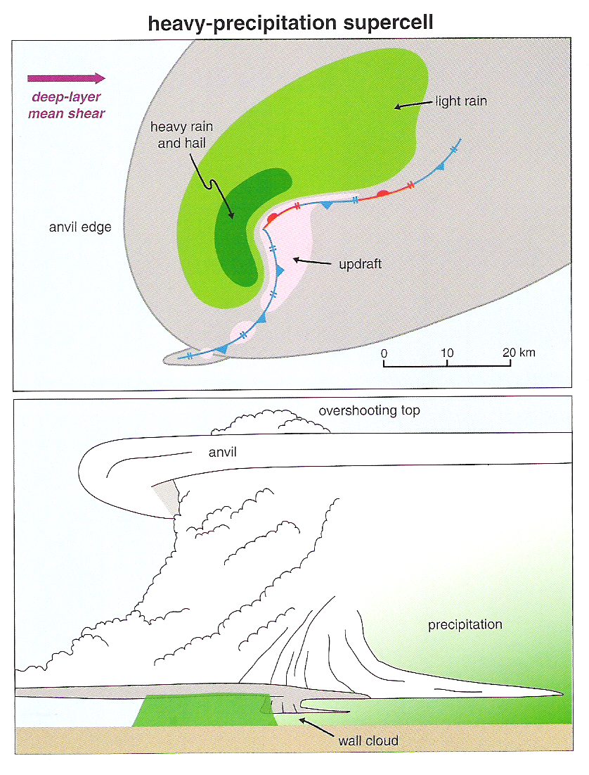
High Precipitation Supercell Structure
Upper-level storm-relative winds are comparatively slow, and often the environments in which HP supercells form are comparatively moist (such as in the southeast US).
Hydrometeors, and thus precipitation, largely envelop the updraft with HP supercells, obscuring them visually.
Markowski and Richardson (2010), their Fig. 8.26

Slide 12
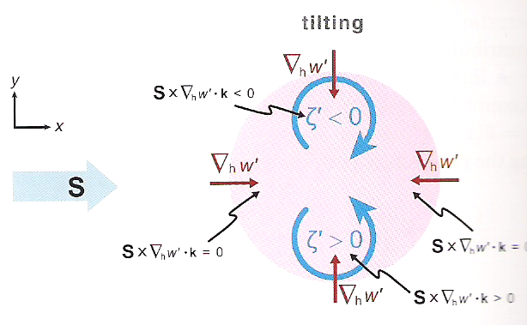
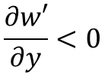
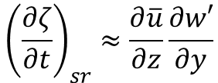
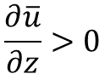
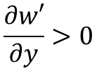
Updraft-Induced Tilting
$$\frac{∂w′}{∂y}<0$$
For westerly shear,
ζ decreases with time
$${\left(\frac{∂ζ}{∂t}\right)}_{sr}≈\frac{∂\overline{u}}{∂z}\frac{∂w′}{∂y}$$
$$\frac{∂\overline{u}}{∂z}>0$$
$$\frac{∂w′}{∂y}>0$$
ζ increases with time
Markowski and Richardson (2010), their Fig. 8.29

Slide 13
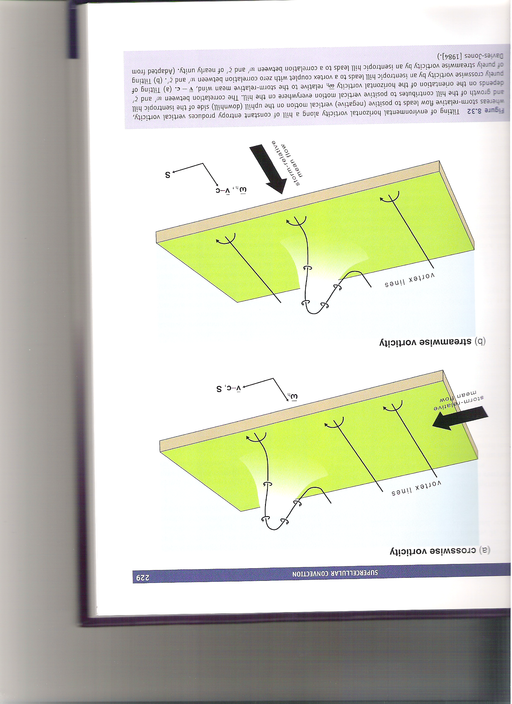
Updraft-Induced Tilting
Neither the tilted anticyclonic or cyclonic vertical vorticity anomaly are advected beneath the updraft by the storm-relative flow.
The tilted cyclonic vertical vorticity anomaly is advected beneath the updraft by the storm-relative flow, where it can amplify by stretching.
Markowski and Richardson (2010), their Fig. 8.32

Slide 14
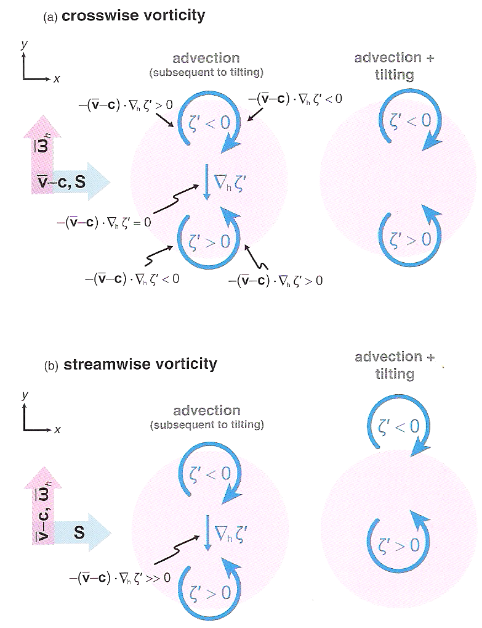
Tilting of Crosswise vs. Streamwise Vorticity
The horizontal vorticity and storm-relative motion vectors are perpendicular: favors neither vortex.
The horizontal vorticity and storm-relative motion vectors are in the same direction: favors cyclonic vortex.
Markowski and Richardson (2010), their Fig. 8.30

Slide 15
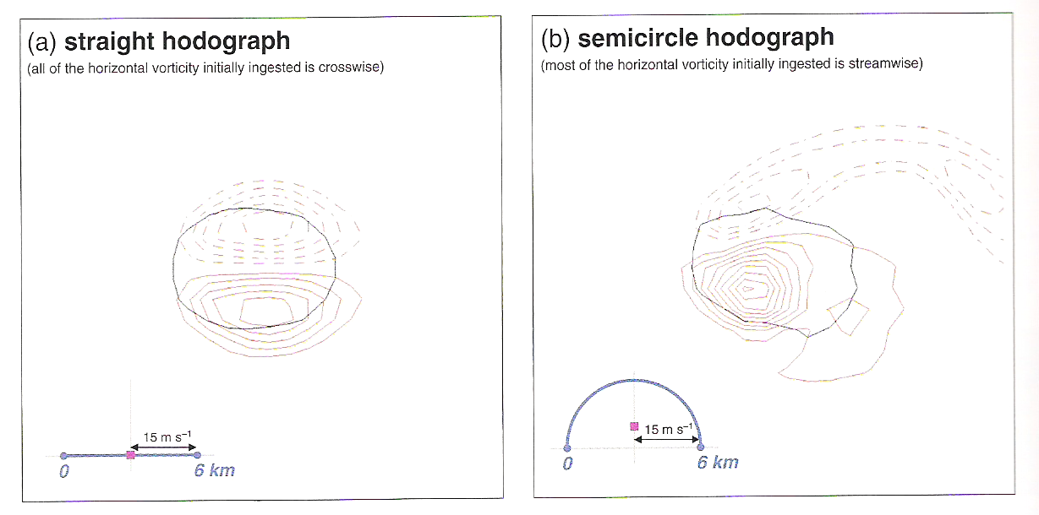
Tilting of Crosswise vs. Streamwise Vorticity
In (b), note the cyclonic vorticity amplification that occurs after advection by stretching.
Markowski and Richardson (2010), their Fig. 8.31

Slide 16
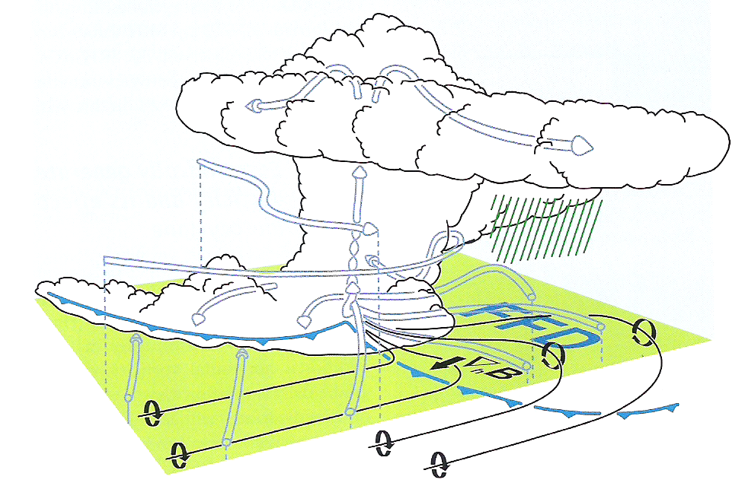
Baroclinic Generation of Horizontal Vorticity
FFD: ∂B/∂y < 0, generating –ξ (westward-pointing vortex lines).
Storm-relative inflow points along these vortex lines – streamwise vorticity!
Environment: westerly shear gives northward-pointing vortex lines.
Markowski and Richardson (2010), their Fig. 8.34

Slide 17
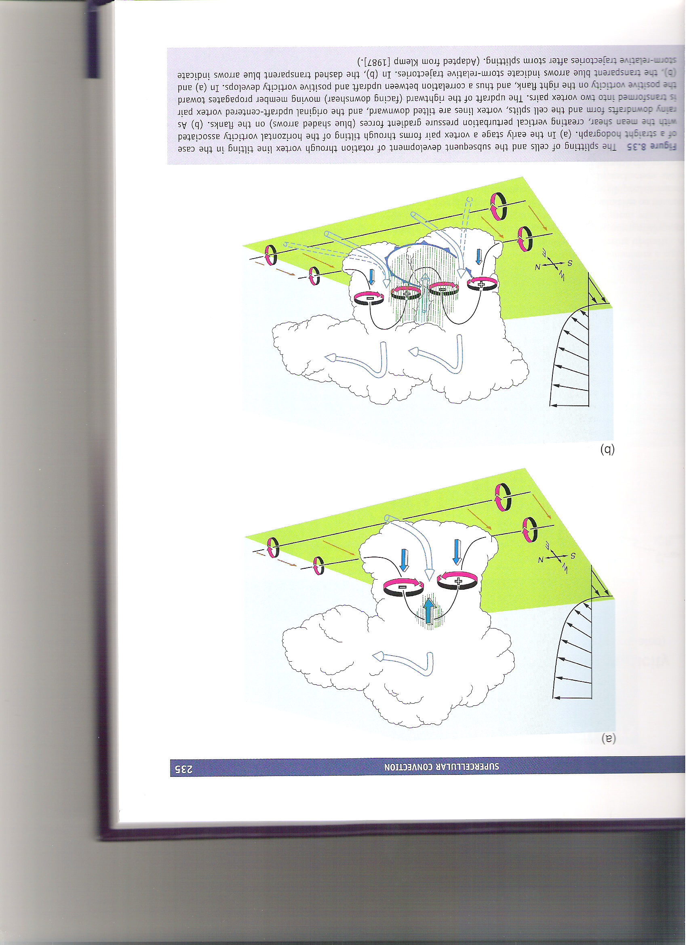
Non-Linear Dynamical Forcing
L
L
L
L
L
L
The hodograph here is straight, such that all horizontal vorticity is crosswise.
Markowski and Richardson (2010), their Fig. 8.35

Slide 18
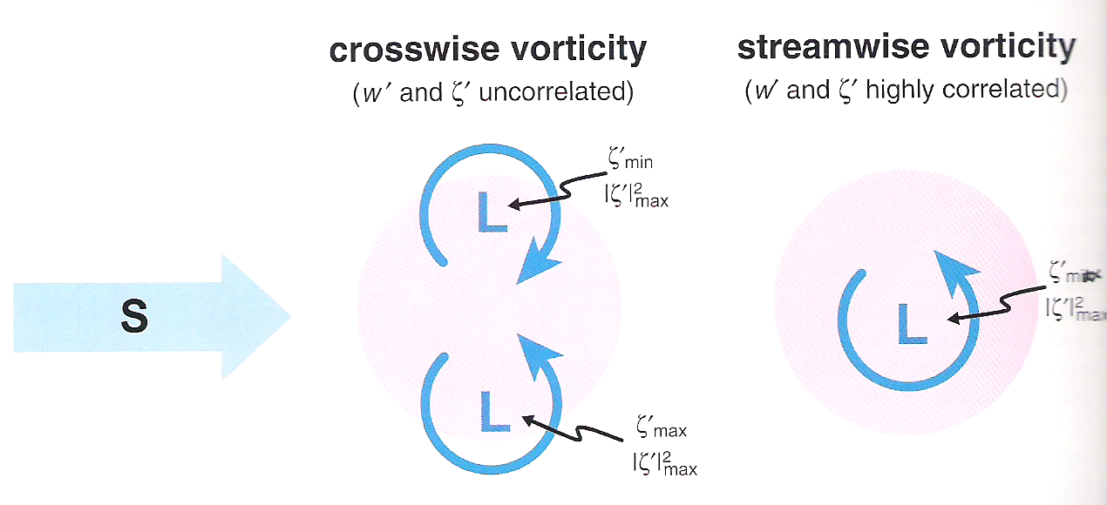
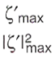
Non-Linear Dynamical Forcing
Streamwise vorticity ensures the cyclonic vertical vorticity anomaly is instantaneously advected beneath the updraft, so the perturbation vertical PGF is collocated with the updraft.
Markowski and Richardson (2010), their Fig. 8.36

Slide 19
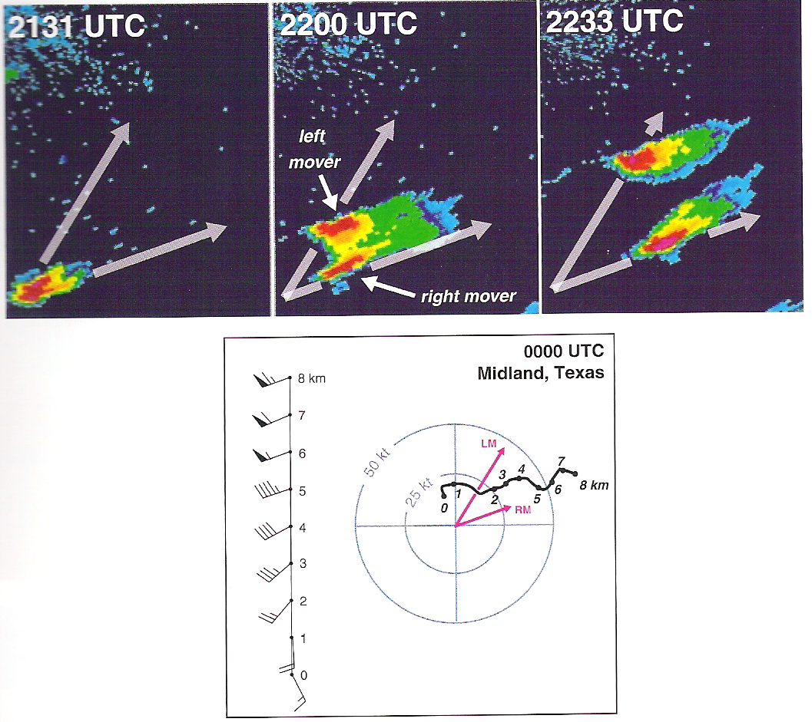
Splitting Supercell Example
The hodograph here is largely straight, so both left- and right-splits form and persist.
Markowski and Richardson (2010), their Fig. 8.37

Slide 20
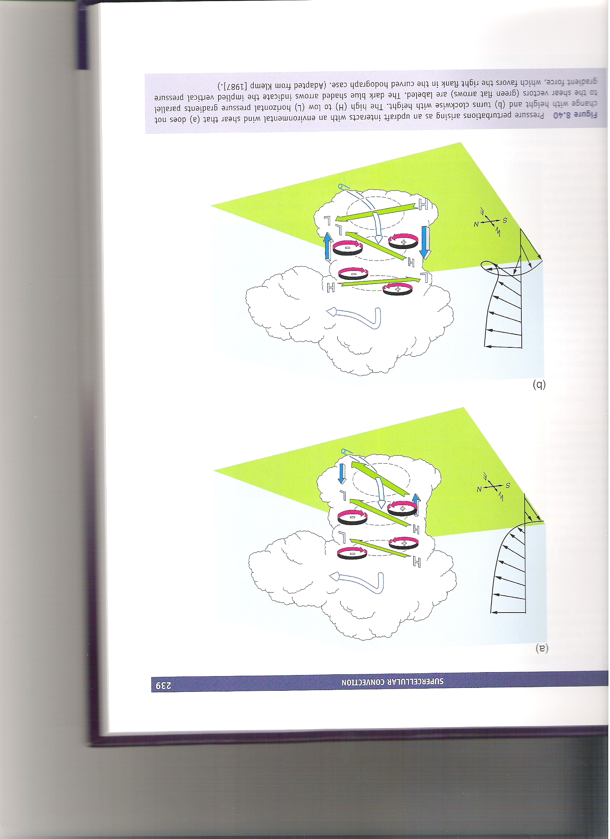
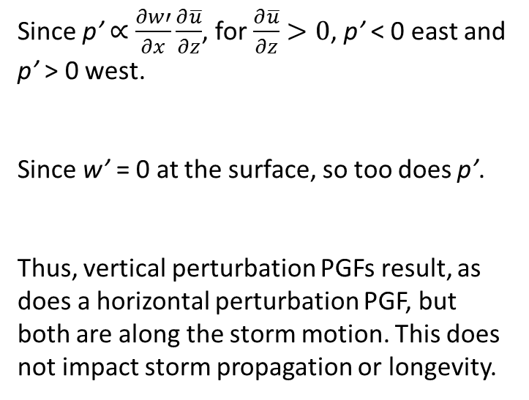
Linear Dynamical Forcing: Straight Hodograph
Since p’ $∝$ $\frac{∂w′}{∂x}\frac{∂\overline{u}}{∂z}$, for $\frac{∂\overline{u}}{∂z}>0$, p’ < 0 east and p’ > 0 west.
Since w’ = 0 at the surface, so too does p’.
Thus, vertical perturbation PGFs result, as does a horizontal perturbation PGF, but both are along the storm motion. This does not impact storm propagation or longevity.
Markowski and Richardson (2010), their Fig. 8.40a

Slide 21
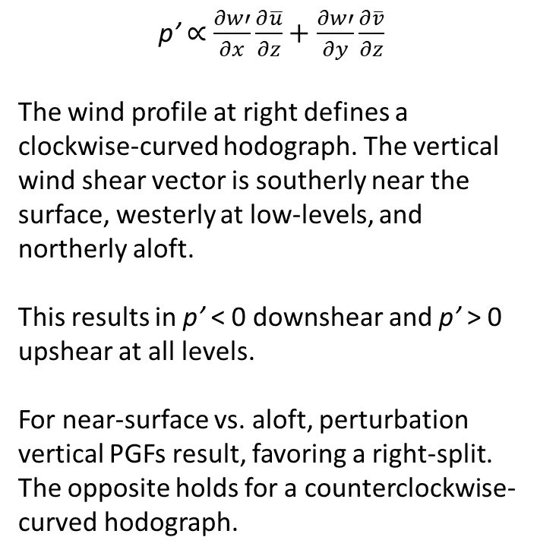
Linear Dynamical Forcing: Curved Hodograph
p’ $∝$ $\frac{∂w′}{∂x}\frac{∂\overline{u}}{∂z}+\frac{∂w′}{∂y}\frac{∂\overline{v}}{∂z}$
The wind profile at right defines a clockwise-curved hodograph. The vertical wind shear vector is southerly near the surface, westerly at low-levels, and northerly aloft.
This results in p’ < 0 downshear and p’ > 0 upshear at all levels.
For near-surface vs. aloft, perturbation vertical PGFs result, favoring a right-split. The opposite holds for a counterclockwise-curved hodograph.
Markowski and Richardson (2010), their Fig. 8.40b

Slide 22
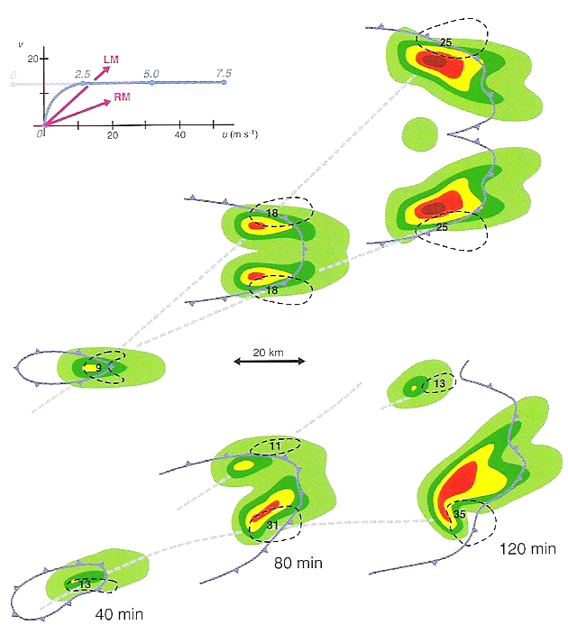
Right- versus Left-Split Supercells
Straight Hodograph: all horizontal vorticity is initially crosswise. Splitting occurs, with neither split preferred. Deviant motion results; for the left-split, a subsequent left-split is preferred, whereas for the right-split, a subsequent right-split is preferred.
Curved Hodograph: horizontal vorticity is initially a mix of crosswise and streamwise. Splitting occurs. The presence of clockwise hodograph curvature favors the right-split. Deviant motion to the right reduces splitting likelihood and supports the right-mover more with time.
Markowski and Richardson (2010), their Fig. 8.41

Slide 23
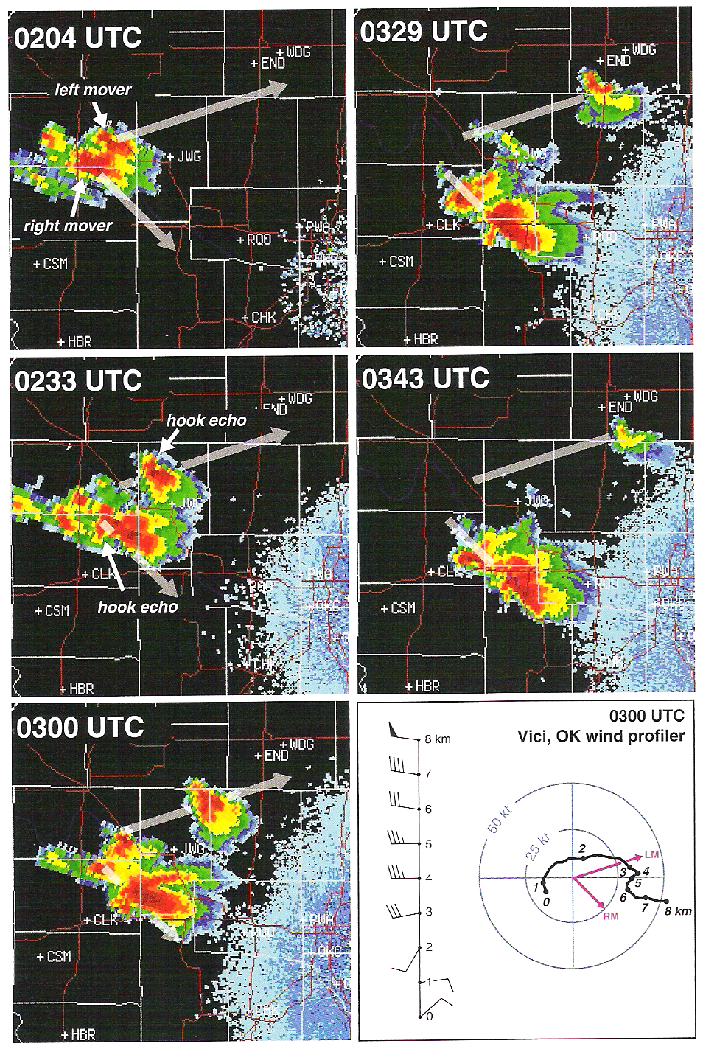
Right- versus Left-Split Supercells
In this case, the hodograph has large clockwise curvature in the lowest 2-3 km. From 4-7 km, it has modest counterclockwise curvature. Crosswise vorticity is non-zero, however.
Non-linear forcing promotes a splitting supercell in this environment.
Linear forcing favors the surface-based right-split, although the counterclockwise curvature aloft (and implied antistreamwise vorticity from LM) supports the left-mover for ~1 h after splitting.
Markowski and Richardson (2010), their Fig. 8.42

